Slide 1

CST1302 Foundation of Web Programming – Lecture 5
A. A. Datti

Slide 2
Course Outline
Introduction to WWW
Structuring and Formatting with HTML
Basic Text
Lists
Hyperlinks
Multimedia
Tables
Forms
Styling with CSS

Slide 3
HTML Table
Tables are used on web pages to organize information in tabular form
Composed of rows and columns – similar to a spreadsheet.
Each individual table cell is at the intersection of a specific row and column.
Configured with table, tr, and td elements

Slide 4
Example
Each table begins with a <table> tag and ends with a </table> tag.
An optional <caption></caption> tag can be used to specify the caption of the table
Each table row begins with a <tr> tag and ends with a </tr> tag. (An optional) Header row begins with <th> tag and ends with a </th>
Each cell (table data) begins with a <td> tag and ends with a </td> tag.
The <td> elements are the data containers of the table. They can contain all sorts of HTML elements; text, images, lists, other tables, etc.

Slide 5
HTML Table Example
Basic Table
<table> <caption>Web Design in BUK</caption>
<tr>
<th>Course Code</th>
<th>Course Name</th>
</tr>
<tr>
<td>CST1302</td>
<td>Foundations of Web Programming</td>
</tr>
<tr>
<td>CSC2233</td>
<td>Advanced Web Programming</td>
</tr>
</table>

Slide 6
HTML Table Example 2
Using border attribute
<table border=1 > <caption>Web Design in BUK</caption>
<tr>
<th>Course Code</th>
<th>Course Name</th>
</tr>
<tr>
<td>CST1302</td>
<td>Foundations of Web Programming</td>
</tr>
<tr>
<td>CSC2233</td>
<td>Advanced Web Programming</td>
</tr>
</table>

Slide 7
HTML colspan and rowspan Attributes
Table cells have two important attributes:
Colspan: defines how many columns the cell occupies
Rowspan: defines how many rows the cell occupies
<table border="1">
<tr>
<td colspan=“2”> Birthday List</td>
</tr>
<tr>
<td>Aisha</td>
<td>11/08</td>
</tr>
<tr>
<td>Adam</td>
<td>4/17</td>
</tr>
</table>

Slide 8
HTML rowspan Attribute
<table border="1">
<tr>
<td rowspan="2">This spans two rows</td>
<td>Row 1 Column 2</td>
</tr>
<tr>
<td>Row 2 Column 2</td>
</tr>
</table>

Slide 9
Nested Tables
Table data “cells” (<td>) can contain nested tables (tables within tables):
<table> <tr> <td>Contact:</td> <td> <table> <tr> <td>First Name</td> <td>Last Name</td> </tr> </table> </td> </tr> </table>

Slide 10
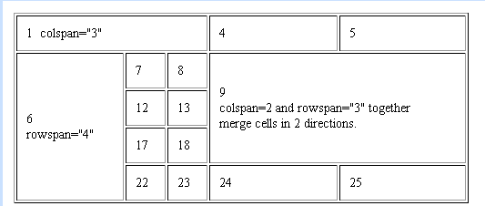
…..
Demonstrating rowspan and colspan attributes

Slide 11
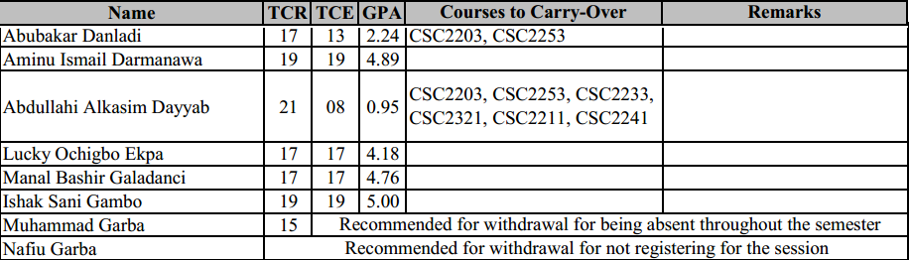
Exercise
End of Semester Result Summary

Slide 12
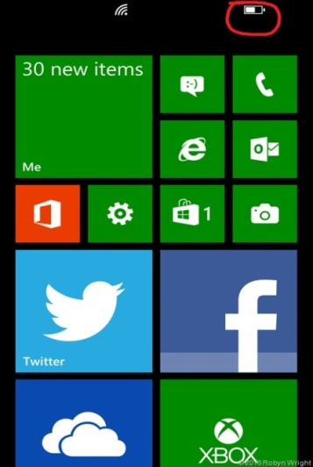
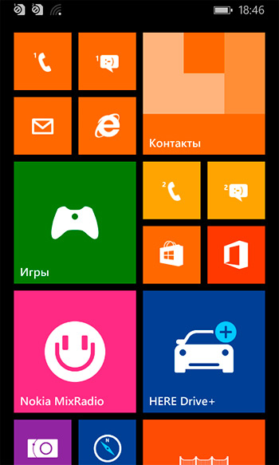
Assignment
Personalized Lecture Timetable
Must contain
Your Picture
at least one animated image or a short movie (muted autoplay and loop)

